Slide 1




Development of master curricula for natural disasters risk management in Western Balkan countries
Flood Risk analysis and management in urban environments
Dr. Susanna Naso, Prof. G. T Aronica
University of Messina – Department of Engineering, ITALY
Teaching staff training and study visit
Messina, 19th -21st September 2017
Project number: 573806-EPP-1-2016-1-RS-EPPKA2-CBHE-JP
"This project has been funded with support from the European Commission. This publication reflects the views only of the author, and the Commission cannot be held responsible for any use which may be made of the information contained therein"

Slide 2
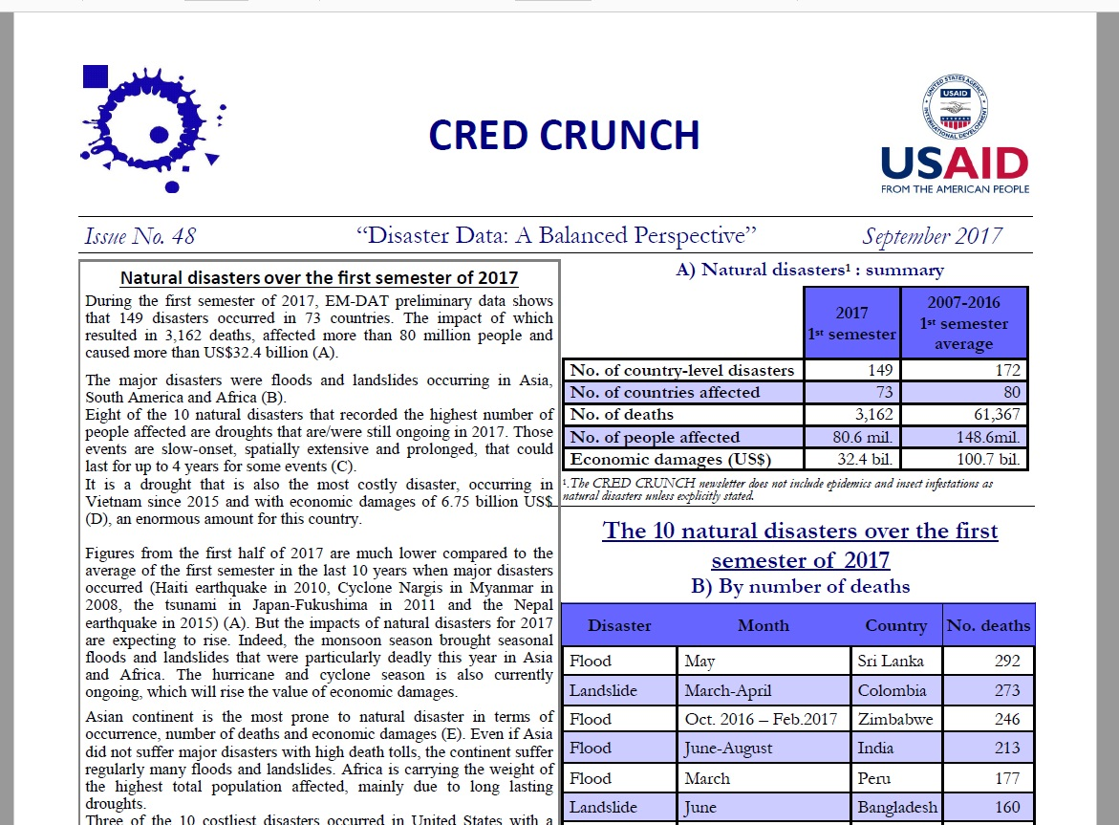
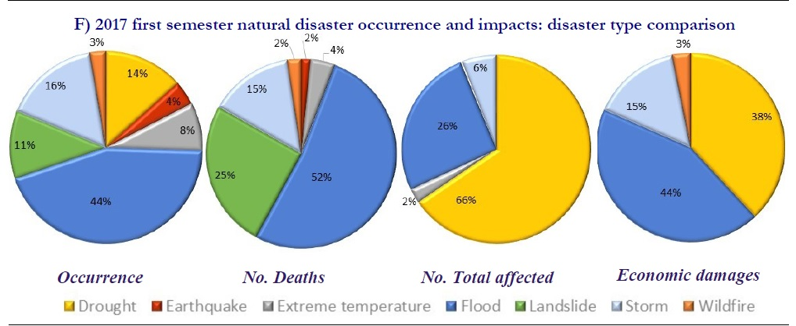
Introduction
Development of master curricula for natural disasters risk management in Western Balkan countries
A flood is defined by the Oxford English Dictionary as “An overflowing or irruption of a great body of water over land in a built up area not usually submerged.”
Notes:
Flooding is a global phenomenon which causes widespread devastation, economic damages and loss of human lives.
The Centre for Research on Epidemiology of Disasters (CRED), which promotes research and training on humanitarian emergencies, particularly in public health, launched 30 years ago the Emergency Events Database (EM-DAT). EM-DAT was created with the initial support of the World Health Organisation (WHO) and the Belgian Government.
Basing on this database and together with the UN Office for Disaster Risk Reduction (UNISDR), a report on the human costs of weather-related disasters occurred between 1995 and 2015. According to it, flooding alone accounted for 47% of all weather-related disasters, affecting 2.3 billion people (even if other type of disasters results to be more dangerous in terms of number of lives lost). In this slide, a figure from the report of CRED about natural disasters occurred worldwide during the first semester of 2017, confirming this trend.

Slide 3
From flood defence to flood risk management
Development of master curricula for natural disasters risk management in Western Balkan countries
Flood risk management can be defined as the “continuous and holistic societal analysis, assessment and mitigation of flood risk” (Schanze, 2006).
Or as “a process of continuous analysis, adjustment and adaptation of a flooding system (including both structural and non-structural actions) taken to reduce flood risk” (FLOODsite, 2009a; HR Wallingford, 2007).
Main characteristics | Security approach | Risk approach
Aim | protection against threat emanating from flood events | develop a strategy how to handle flood risk, define which level of risk is acceptable
Terminology | danger, threat, security, protection | risk, residual risk, risk evaluation, risk management, risk governance
Scenarios | medium-probability events as the standard level of protection | high-/medium- and low-probability events, priorities regarding level of protection
Measures | focus on structural measures | combination of structural and non-structural measures
Involved parties | sectorial planning (water authority), top-down, implementation gap | interdisciplinary, bottom-up elements
Spatial focus | local solutions for local problems, oriented at administrative borders | across administrative borders, catchment-based
Time aspect | short-term solutions, event-driven, “trial and error” | medium-/long-term solutions, prevention, regular revisions
Comparison of security approach and risk approach (Heintz et al., 2012; Wagner, 2008).
Notes:
The concept of risk implies a transition from the classical approach of defending a territory from flood hazard, through structural measures that modify the characteristics of the flood event, to the approach of reducing flood risk, through structural and non-structural measures that act on both flood hazard and its consequences. This include a shift away from the single objective of flood defence towards management of flood risks proper through also influencing the vulnerability of society.
Three main developments:
managing all flood events focusing on the idea of coping with risk, instead of defining a design flood event from which implement protections;
risk-informed decision making, so that risk estimates may be used to inform multiple decision makers and the amount invested in risk reduction could be in proportion to risk magnitude and to the cost-effectiveness with which that risk may be reduced;
integrated system approaches, complementing or replacing flood defence by (non-structural) measures for reducing effects of flooding.
Including the possible consequences in flood risk management adds to its implementation all the many variables influencing these consequences, making flood risk management a complex, multi-variate problem facing many uncertainty sources.

Slide 4
Flood risk management in EU
Development of master curricula for natural disasters risk management in Western Balkan countries
Flood risk management plans “shall address all aspects of flood risk management focusing on prevention, protection, preparedness, including flood forecasts and early warning systems” (European Flood Directive 2007)
How to verify the effectiveness of non-structural measures?
Notes:
Flood risk management plans, as pointed out in the European Flood Directive, “shall address all aspects of flood risk management focusing on prevention, protection, preparedness, including flood forecasts and early warning systems” with the aim of “reducing potential adverse consequences of flooding”.
The use of prevention measures that do not interfere on flood’s features require the elaboration of methodologies and strategies aimed at verifying their effectiveness. All over the world, public bodies and academics published some studies on the effectiveness of non-structural measures, but the lack of data on it (or their coarseness) makes their reliability hard to know.
In fact it is not so easy to understand how the use of hazard-independent measures varies the attitude of a territory in suffering a negative event’s consequences.

Slide 5
The variables of risk equation
Development of master curricula for natural disasters risk management in Western Balkan countries
R
V
E
H
“characteristics and circumstances of a community, system or asset that make it susceptible to the damaging effects of a hazard” (UNISDR 2009)
Notes:
If we consider the integral equation of risk, where H is the hazard, V is the vulnerability, E is the entity, the variable describing this attitude is vulnerability, defined exactly as “the characteristics and circumstances of a community, system or asset that make it susceptible to the damaging effects of a hazard”.
Actually, there are different definitions of the term vulnerability with respect to natural hazards research.
From a natural science perspective, studies on vulnerability focus on the susceptibility of physical systems in areas at risk to natural processes, with the aim of providing information useful in risk mitigation strategies.
Vulnerability embodies also the capacity of a system to anticipate, cope with and resist flooding (resistance) and the capacity of the system to recover from the impact of flooding (resilience).
The interpretation assumed here is now reported. Vulnerability is clearly related to the consequences of a natural hazard, which are generally measured in terms of damage or losses. Likewise, given its general connection to elements’ susceptibility, it can be assessed as the expected loss degree of an element (or set element) at risk as a consequence of a hazardous event.
Consequently, vulnerability can assume values ranging from 0 to 1, as the expected degree of loss varies from no damage to complete disruption.

Slide 6
Development of master curricula for natural disasters risk management in Western Balkan countries
The variables of risk equation
R
V
E
H
T
€
Damage %
h
h
Notes:
So, H describes the severity of the event that may hit a territory with a certain returning period; E is the entity (value) of the elements at risk; V is, for the definition we already gave, the percentage of damage that assets in areas at risk may suffer.

Slide 7
Development of master curricula for natural disasters risk management in Western Balkan countries
The variables of risk equation
R
V
E
H
Hydraulic Models
Vulnerability models
h
Damage [€]
T
T
Notes:
In scientific literature there are a lot of studies dedicated to the evaluation of H and over time have been developed many hydrological and hydraulic models able to describe us the features of a given return period event. The existence of consistent databases of elements involved (measures of rainfall, discharge ...) has been a fundamental element of this goal and, today, we are able to derive the results and the uncertainties associated with them. Conversely, studies addressed to the evaluation of flood vulnerability are few and at the mercy of so many elements of uncertainty difficult to quantify.

Slide 8
Development of master curricula for natural disasters risk management in Western Balkan countries
Flood Risk assessment in Sicily
In Sicily the risk assessment is currently carried out by means of the use of matrixes which provide flood hazard and flood risk in function of the event return period, the inundation depths and the exposure classes of assets at risk (Regione Sicilia, 2004). In this approach, the vulnerability has a constant value preventively equal to 1.
The idea of bypassing the assets’ economical value and using exposure classes, actually, may allow to reduce uncertainties in those cases in which strong databases supporting the analysis lack. Conversely, fixing the vulnerability default value equal to 1 inhibit any assessment of the variations in this parameter.
Water depth | Return period
 | 50 | 100 | 300
h ≤ 0.3 m | H1 | H1 | H1
0.3 < h < 1 m | H2 | H2 | H2
1 < h < 2 m | H4 | H3 | H2
h > 2 m | H4 | H4 | H3
Risk | E1 | E2 | E3 | E4
H1 | R1 | R1 | R2 | R2
H2 | R1 | R2 | R3 | R3
H3 | R2 | R2 | R3 | R4
H4 | R2 | R3 | R4 | R4
Notes:
In Sicily the risk assessment is currently carried out by means of the use of matrixes which provide flood hazard and flood risk in function of the event return period, the inundation depths and the exposure classes of assets at risk. In this approach, the vulnerability has a constant value preventively equal to 1: this means hypothesize the complete disrupt of every element reached by the water. This methodology substantially give as result how hazard varies in different zones more or less densely populated: in fact, the exposure classes give a general information on buildings (economic and strategic) value and no information on vulnerability variations is included. It does not allow for quantitative assessment of risk (expected damage), which should be useful in flood risk management plans redaction or in cost-benefit analysis for the assessment of the effectiveness of protection strategies. The idea of bypassing the assets’ economical value and using exposure classes, actually, may allow to reduce uncertainties in those cases in which strong databases supporting the analysis lack. Conversely, fixing the vulnerability default value equal to 1 inhibit any assessment of the variations in this parameter and, than, any possible comparison among different combinations of non-structural measures aimed at evaluating their effectiveness.

Slide 9
Floods in urban environments
Development of master curricula for natural disasters risk management in Western Balkan countries
Urban environments can be affected by river flooding, coastal floods, pluvial and ground water floods, flash floods, artificial system failures.
Urban floods typically stem from a complex combination of causes, resulting from a combination of meteorological and hydrological extremes, such as extreme precipitation and flows. However they also frequently occur as a result of human activities, including unplanned growth and development in floodplains, or from the breach of a dam or an embankment that has failed to protect planned developments.
Notes:
Floods (as any other natural disaster) are much more dangerous when happen in urbanized areas. When talking about floods, a first important distinction has to be made about which flood hazard can affect the urban environment, as river flooding, coastal flooding, flash floods, pluvial flooding.. have different characteristics and can be faced with completely different precautionary and emergency measures. Another aspect to be taken into account is that urban evolution adds to flood risk assessment in future scenarios a great number of uncertain variables (urban growth, changes in exposure and vulnerability, changes in probability of flooding..), thus making flood risk management even more difficult and uncertain.
Defending against future floods will therefore require more robust approaches to flood management that can cope with larger uncertainty or be adaptive to a wider range of futures. This could lead to a greater reliance on more flexible, incremental approaches to flood risk management, the incorporation of greater flexibility into the design of engineered measures, or acceptance of potential over-specification for inflexible measures.

Slide 10
Development of master curricula for natural disasters risk management in Western Balkan countries
Flood damages
Damage assessment of natural hazards supplies crucial information to decision support and policy development in the fields of natural hazard management and adaptation planning to climate change.
As flood risk management is becoming the dominant approach of flood control policies throughout Europe, the estimation of economic flood damage is gaining greater importance, but it still represents a challenge.
 | Direct | Indirect
Tangible | Damage to buildings and contents; disruption of infrastructures; erosion of agricultural fields; costs of evacuation and rescue; interruption of economic activities inside the flooded area; clean-up costs. | Interruption of public services outside the flooded area; economic losses of companies outside the flooded areas; costs caused by the interruption of transport infrastructures; businesses migration.
Intangible | Casualties; accidents; loss of objects with an affective value; psycological uneasiness; damages to cultural heritage; environmental impact. | Anxiety; loss of trust in authorities.
Notes:
The term damage embodies a wide range of meanings and interpretation, as it has been and is used by different experts facing different problems, each one dealing with his own discipline (economy, law, medicine, geography, etc.).
Generally speaking, it is possible to find some common lines in these multiple interpretations. Damage is always the consequence of an action or an event; it may affect material or immaterial goods; the preventive assessment of possible damage is the starting point in every risk management strategy.
In general, flood damages are classified as a combination of direct, indirect, tangible and intangible losses. Direct losses are due to the direct contact of elements at risk with the flow; indirect losses include all consequences of the flood event that are not directly connected to the flow such as the disruption of public services and commercial activities after the flood that may even be outside the flood extent. In parallel, tangible losses can be specified in monetary terms, while intangible losses are not traded in a market and cannot be expresses in monetary terms.
Despite in some studies is underlined the consistency of intangible damages, the majority of literature analysis is aimed to the assessment of tangible losses and, in particular, to direct tangible ones. In fact, direct damages are usually present in any damage assessment, indirect losses are often roughly estimated and intangibles are frequently ignored or simply mentioned.
While it is easy to imagine, because of their definition, the difficulties in evaluating intangible losses, even flood tangible damages assessment is still a research challenge: the main obstacles in these research fields are the lack of available and consistent database and the many variables involved in the problem.

Slide 11
Development of master curricula for natural disasters risk management in Western Balkan countries
Influencing variables in flood damage assessment
Thieken et al. (2005). Flood damage and influencing factors: New insights from the August 2002 flood in Germany. Water Resources Research
Notes:
V is influenced by: hydrodynamic factors, like flow velocity, flood frequency and duration, contamination indicator; building characteristics, like its type and quality, the floor space or the number of flats; precautionary measures implemented at different scales, like early warning and emergency measures, preparedness, private precautionary measures.
Thieken et al. (2005), stating from the concept that the damage of a building is dependent upon the load on the structure on the one hand and its resistance on the other hand, classified the influencing factors in impact and resisting ones and studied their influence on flood damages to private households. Thanks to a survey among flood-affected private households undertaken in Germany in the aftermath of the 2002 flood, they found that impact variables weight more than resistance ones, but an important effort to classical damage studies would come by accounting more variables in respect to the only water depth (e.g. contamination).
As already said, most of the presented damage influencing factors are neglected in damage modelling, since they are difficult to predict, very heterogeneous in space and time and there is a very limited information on their effect.

Slide 12
Development of master curricula for natural disasters risk management in Western Balkan countries
Spatial and temporal scales
The damage analysis can be carried out at different spatial and temporal scales. This information is important and becomes central when comparing different methodologies and applying them to different contests in respect to the one they are developed for.
About the spatial scales, the data can be referred to micro-scale, meso-scale, macro-scale.
Methodologies (e.g. damage functions) developed for a specific spatial scale need upscaling and downscaling procedures to be adapted to other scales’ analyses.
The same attention must be paid when using databases: the data collected have always a spatial scale and the instruments derived follow the same scale.
Regarding the temporal scale, flood can cause long-term consequences, such as health effects, which are not captured if a too short time horizon of the damage assessment is chosen.
There are not official or widely recognized definitions for spatial and temporal scales.
Notes:
The damage analysis can be carried out at different spatial and temporal scales. This information is important and becomes central when comparing different methodologies and applying them to different contests in respect to the one they are developed for.
About the spatial scales, the data can be referred to:
- micro-scale, when single elements at risk (buildings, commercial activities, infrastructures, …) are considered and damages refer to each of them;
- meso-scale, when elements at risk are aggregated giving as result land-use units (e.g. residential areas, public use, …) or administrative units (e.g. districts, zip code areas, …);
- macro-scale, when large spatial units (e.g. municipalities, or even regions or countries) are the base for damage assessment.
Methodologies (e.g. damage functions) developed for a specific spatial scale need upscaling and downscaling procedures to be adapted to other scales’ analyses. The same attention must be paid when using databases: the data collected have always a spatial scale and the instruments derived follow the same scale: e.g. when collecting damages at the micro-scale for the empirical derivation of damage functions, these functions must be applied at single units to derive their damages for specific events.

Slide 13
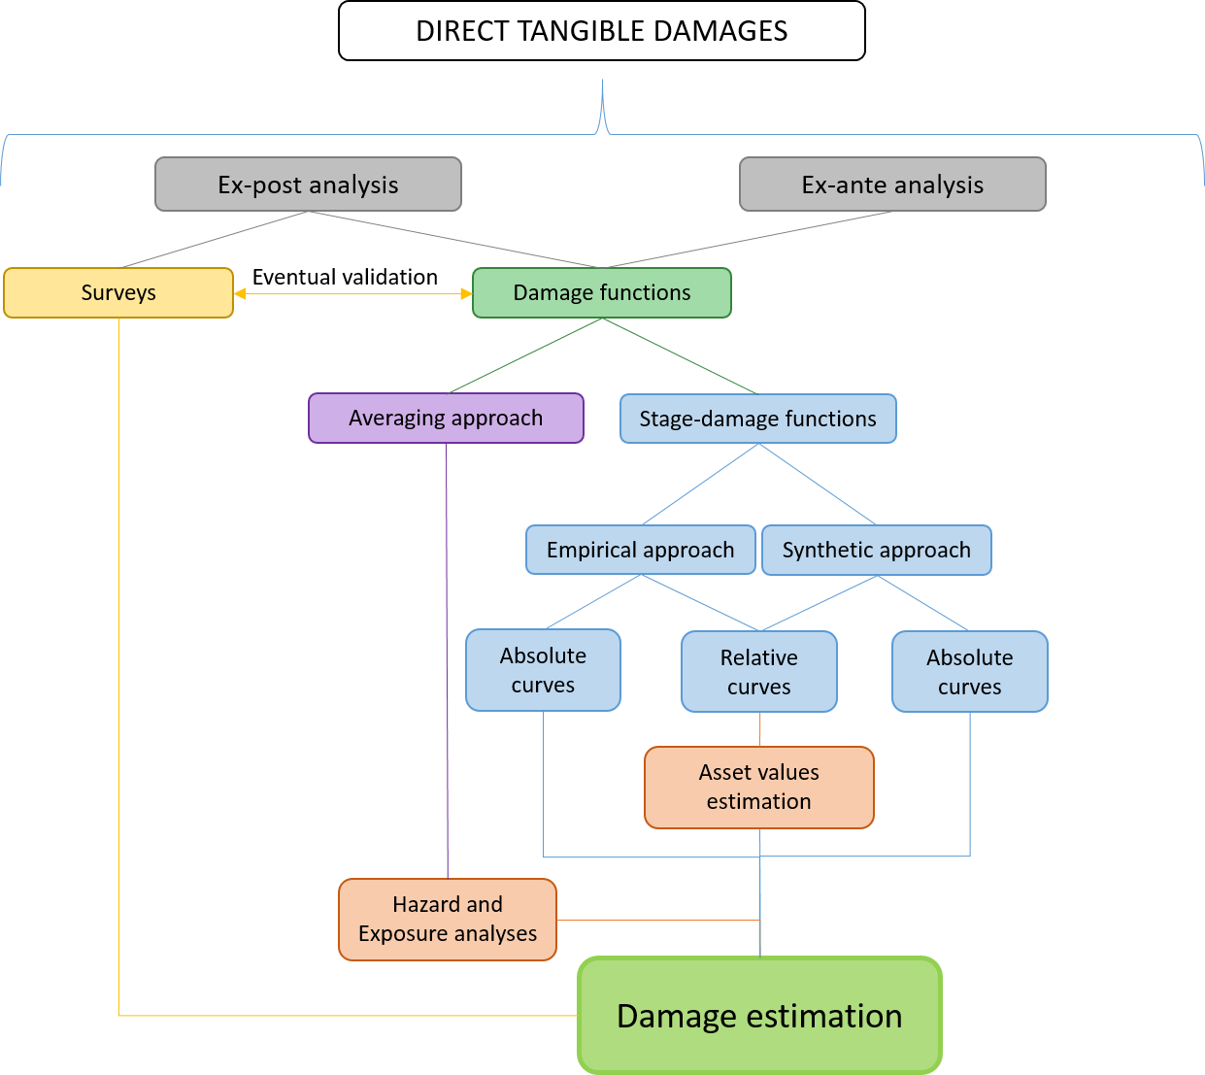
Development of master curricula for natural disasters risk management in Western Balkan countries
Flood damage assessment methods
Notes:
Two macro-classes can be distinguished, in particular:
post-flood damage analysis, implemented after the flood to estimate a focus event consequences (ex-post investigation);
estimation of flood expected damages associated to projections of future scenarios (ex-ante investigation).
The first kind of analyses can be carried out through detailed post-event surveys, where the evaluation consists in the simple quantification of damages after the event, or through the use of pre-existing or ad-hoc derived models (e. g. damage functions), which may be grounded on historical data. In analyses ex-ante, instead, the use of models is inevitable.
The standard approach in direct damages estimation consists in the use of continues stage damage curves connecting the loss only to the water depth and neglecting other influencing factors. There are two main approaches in developing these functions: synthetic approaches and empirical ones. In synthetic approaches (ex-ante analysis) damages are estimated for standardized property types, while the proportional damage is estimated by expert judgement; empirical approaches, instead, use damage data derived from ex-post assessments of actual past events. This second method request the collection of a huge amount of ex-post damage information, but such datasets are still scarce.

Slide 14
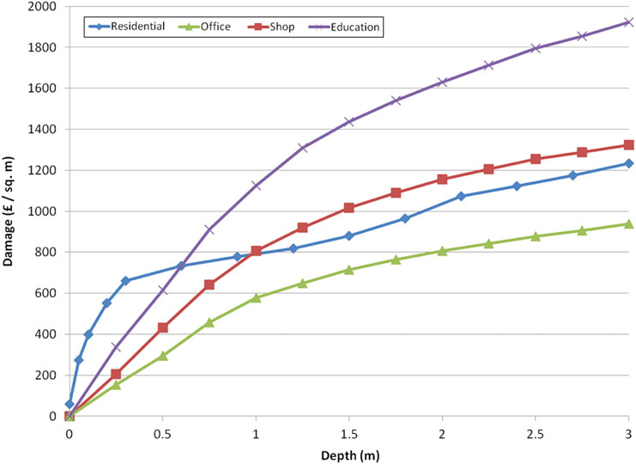
Development of master curricula for natural disasters risk management in Western Balkan countries
Damage curves
(Penning-Rowsell et al. (2005), The benefits of flood and coastal risk management: a manual of assessment techniques. London, UK: Middlesex University Press.)
(Kok, M., Huizinga, H.J., Vrouwenfelder, A.C.W.M, Barendregt, A., (2004). Standard Method 2004. Damage and Casualties caused by Flooding. Highway and Hydraulic Engineering Department.)
Notes:
Last but not least, damage functions can be also classified as:
Relative functions; in this case “the percentage of property value approach” is implemented that is damage is described as a share of the total unit value, per every inundation depth. This approach is followed, for example, in the “Standard Method” in the Netherlands
Absolute functions which supply directly the value of damage per every inundation depth. The MCM can be quoted, again, as an example of absolute functions application.
It can be observed that, looking at stage-damage functions as vulnerability functions, this actually means including, or not, exposure within the vulnerability assessment. Indeed, while relative functions allow for vulnerability only, absolute functions implicitly take into account the extent of the exposed item too (e.g. in term of economic value).

Slide 15
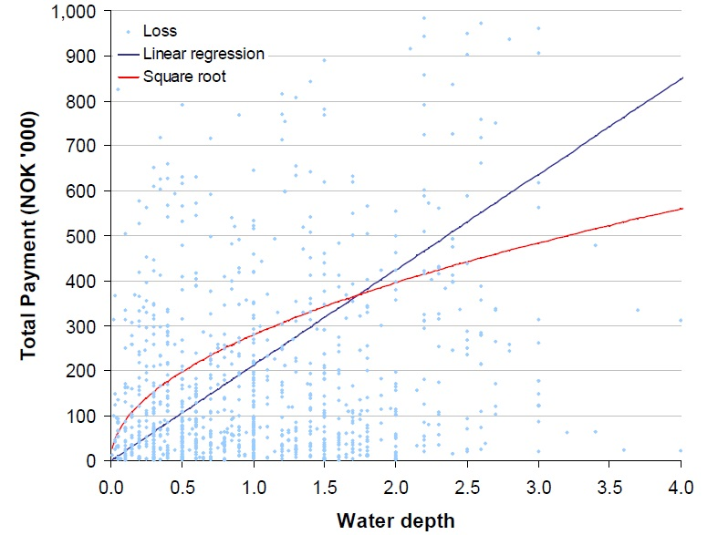
Development of master curricula for natural disasters risk management in Western Balkan countries
Damage curves and uncertainty
Notes:
This is an empirical damage curve derived in Norway: data dispersion is high, with very different damages associated to the same inundation depth. How to account for uncertainties in damage estimation if the data supporting the models are poor and so different? Just a consideration on the limits on empirical damage curves as methodology for damage assessment.

Slide 16
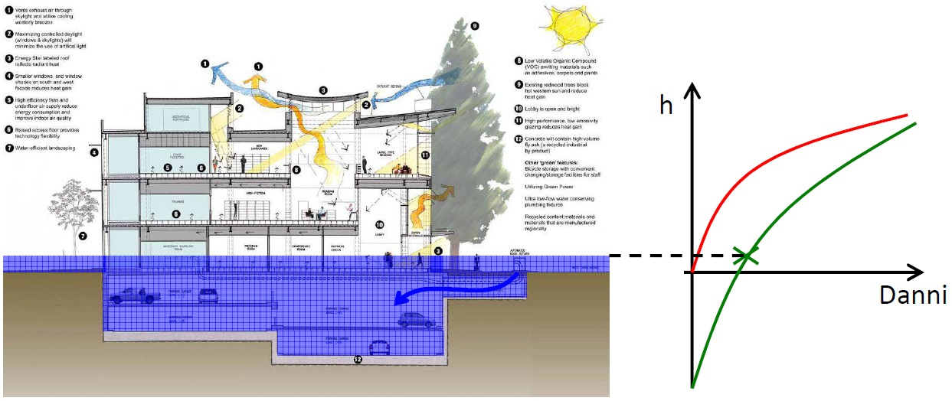
Development of master curricula for natural disasters risk management in Western Balkan countries
Damage curves and uncertainty
Huge damages to basements can occur for small flood depths in the floodplain.
Damages can have no correlation with the event severity in these cases.
Notes:
Just a consideration

Slide 17
Development of master curricula for natural disasters risk management in Western Balkan countries
Damage data
In respect to other aspects of flood risk management, flood damage assessment is still a challenge and one of the main reasons of this is the lack of consistent, high-quality, official damage databases.
Absolute damage functions without any reference to the economic value of the affected buildings, are strictly linked to the contest for which have been derived.
Another limit in the utilization of flood damage data could be their aggregation in predetermined time intervals (e.g. data that have already been aggregated to a regional or national level are unusable at minor scales).
Last but not least, the users of these data should always verify their accuracy, as sources of inaccuracy are multiple and difficult to estimate.
In general, the lack of high-quality basis data is mentioned as one of the main obstacle to flood vulnerability assessment.

Slide 18
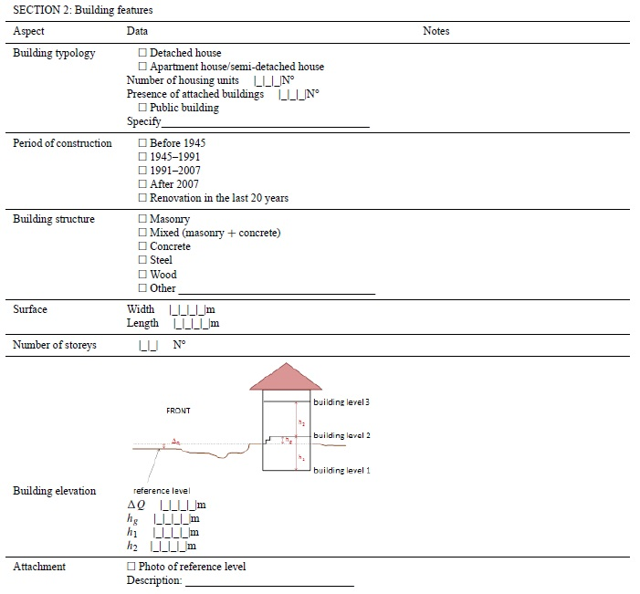


Development of master curricula for natural disasters risk management in Western Balkan countries
Damage data
Notes:
Locally, in Lombardia Region, the RaSDa (Sistema per la Raccolta delle Schede Danni) database has been derived by the introduction of a standard methodology for damage collection after disasters (Molinari, 2010, Molinari et al. 2014). It distinguishes damage occurred to private or public facilities (in this second case, another distinction is between damage to infrastructure and damage to buildings). Damage to contents is included in buildings’ one (either for public or private buildings). A lack in this database is the absence of hazard data, which may however be obtained from public technical agencies, monitoring and forecasting centres and even research centres: the resulting problem to face would be the uncertainties deriving from the attachment of data manipulated by different bodies.
As reported in Molinari et al. (2014): “the existing large-scale databases in Italy are too poor to support a comparison between the results that would be obtained using damage functions from the literature and actual damage recorded in past events. At least one of the three main factors to be related – hazard, vulnerability, or damage – is always missing or too imprecise to develop a comparison”.

Slide 19
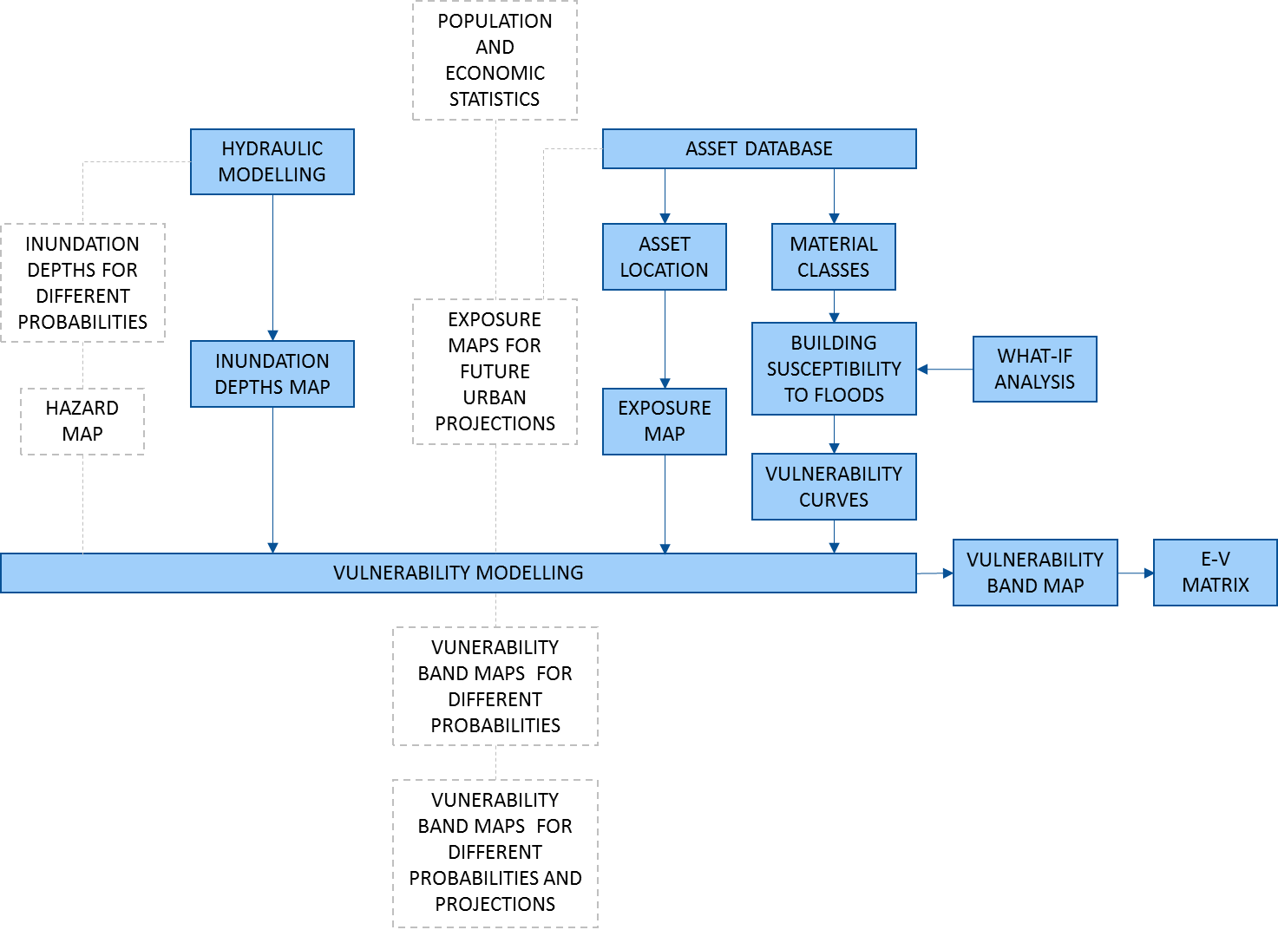
Development of master curricula for natural disasters risk management in Western Balkan countries
An integrated exposure-vulnerability approach for flood risk analysis in urban environments
Notes:
We developed an integrated approach for flood risk assessment which foresees: hydraulic modelling; exposure classification at building scale; synthetic derivation of relative damage (vulnerability) curves incorporating the contribution of movable equipment in commercial buildings to losses; integration of hazard, exposure and vulnerability information for flood risk assessment. It could be further developed for future flood risk assessment, by implementing hazard analyses for projected development of Exposure and the probabilities of plausible events (in Figure in dashed contour lines).

Slide 20
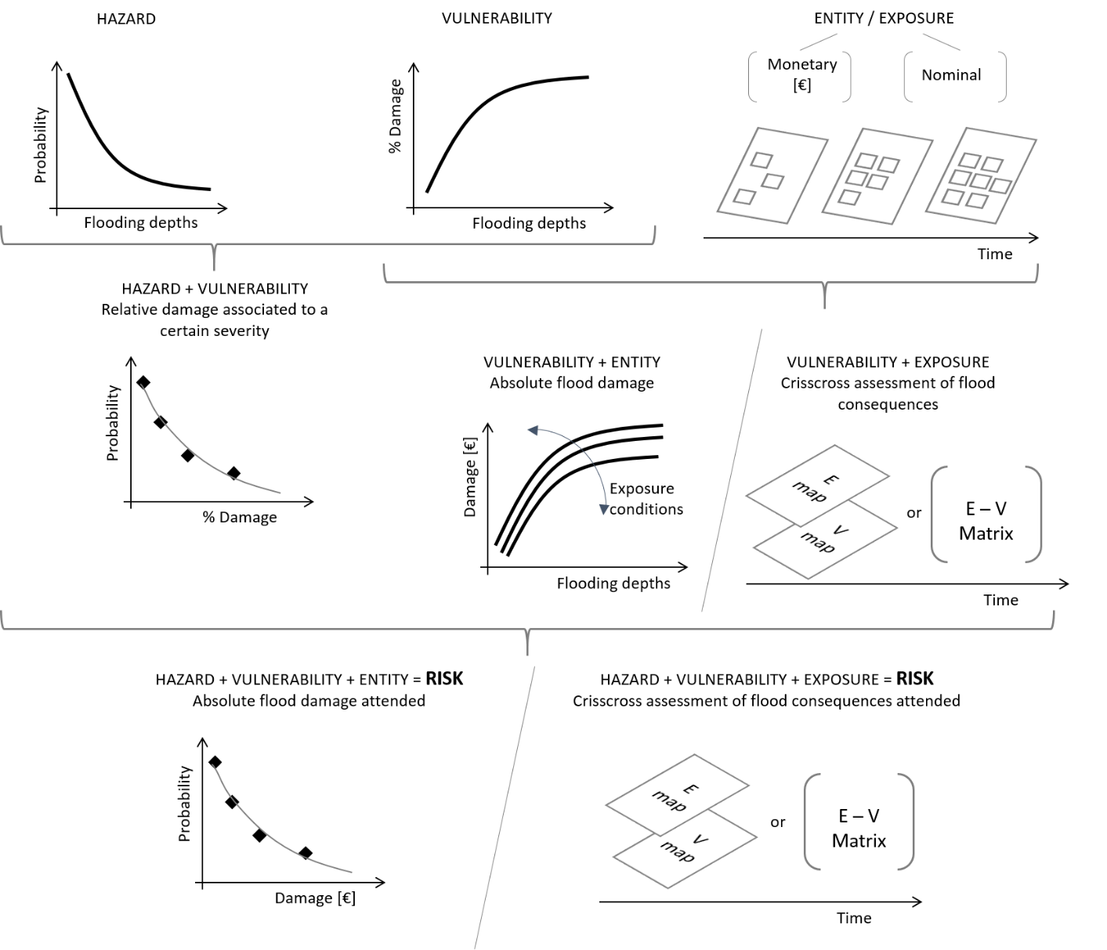
Development of master curricula for natural disasters risk management in Western Balkan countries
An integrated exposure-vulnerability approach for flood risk analysis in urban environments
Notes:
This figure shows the scheme applied in our work that considers different analyzing paths in flood risk assessment, where vulnerability represents the expected loss degree regardless if exposure is expressed in a nominal or a monetary way (named Entity, just to be distinguished). Entity, together with vulnerability, determines their corresponding absolute damage functions. When, instead, Exposure represents the only data available on assets at risk, the vulnerability assessment conduces to a crisscross assessment of flood consequences (for a given event): again, this analysis repeated for different returning periods may led to the same crisscross evaluation of the attended consequences (for events associated to different probabilities of occurrence).

Slide 21
Development of master curricula for natural disasters risk management in Western Balkan countries
An integrated exposure-vulnerability approach for flood risk analysis in urban environments
Exposure category | Exposure sub class | V1 | V2 | V3 | V4 | V5
Sparse houses | Single houses
 | Flats
Industrial and craft settlements | Farmhouses
 | Single houses
 | Sheds
 | Box/Garage
 | Flats
Supermarkets |  |  |  |  |  |  |  |  | low
Residential buildings | Single houses
 | Flats |  |  |  |  |  |  |  | moderate
 | Detached houses
 | Villas |  |  |  |  |  |  |  | medium
Civil Protection Areas and Police offices
Important public buildings | Churches |  |  |  |  |  |  |  | high
 | Town hall and municipal offices
 | Schools |  |  |  |  |  |  |  | extreme
 | Hospitals
Notes:
Considering the uncertainties associated with the vulnerability within a catchment, a banded severity in an Exposure-Vulnerability matrix was used instead of simple one-to-one relationship curves. First, following other studies, we reclassified the vulnerability into five categories with an interval of 0.2 (V1 – V5 in Table) to describe the level of damage. In order to make the matrix more intuitive, the severity in each exposure type is then further banded up to five classes (low, moderate, medium, high, extreme), as color-coded in Table, according to the function and importance of the type. Public buildings or hospital, in fact, may have greater risk even if the vulnerability is low because of their socio-economic role. On the contrast, sparse houses could cope with more extreme conditions, such that the severity was classified as high only for the highest vulnerability (V5) band.

Slide 22
Development of master curricula for natural disasters risk management in Western Balkan countries
An integrated exposure-vulnerability approach for flood risk analysis in urban environments
Starting from the Sicilian Plan Exposure classes, we divided each single element at risk in sub-classes and detailed the ensemble of residential and public buildings considering the constructional and functional typologies.
Notes:
Apart from the direct contact with hazard, various socio-economic functions of a building will lead to different consequences of flooding. To reflect the influences of these factors, we include these factors to determine the exposure. This exposure variable allows us to distinguish the cases for structures with same value but located in zones with different population densities. It can also scale the importance of public buildings based on their functions, which contribute much greater than their value during crisis. In this way, the analysis can be applied to prioritise protection strategies, and allocate the resources in most needed areas or for a specific buildings’ functional class (e.g. schools).
We adopt the density as the major exposure category (X), then refine each into subcategories based on their socio-economic functions (Y). Each exposure sub-category is further refined as subclasses (Z) per the specific/proper entity type, depending on their economic or strategic value. As a result, each detailed exposure classification for elements at risk included a triple index E X.Y.Z. For the case study, X refers to the membership class considered in the Sicilian Flood Risk Plan; Y is relative to the Plan sub-categories; and Z is the entity type inside sub-categories. This level of detail enabled us to perform a vulnerability analysis at building scale. After the exposure classification, for the vulnerability analysis a distinction among buildings’ type is the only necessity: the same curves, in fact, can be used for buildings with the same constructive features, even if they have different functions, such as residential or commercial.

Slide 23
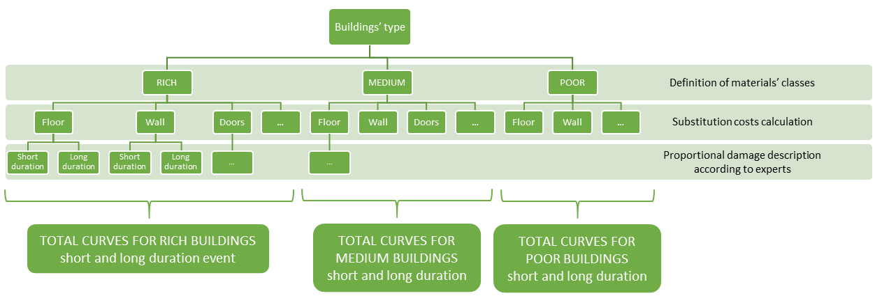
Development of master curricula for natural disasters risk management in Western Balkan countries
An integrated exposure-vulnerability approach for flood risk analysis in urban environments
A synthetic approach for the derivation of relative vulnerability functions was used.
The derivation of vulnerability curves was made as generic as possible: instead of referring to building typologies with a specific geometry inside, we considered the damage suffered by building elements and hypothesized the substitution cost of each element to derive its weight respect to the total substitution costs.
To describe the proportional damage, we submitted a questionnaire to a team of experts.
Notes:
We considered the damage of non-structural building elements and hypothesized the substitution cost of each element to derive its weight respect to the total substitution costs. To describe the proportional damage relative to each element, a questionnaire was distributed to a team of experts, in particular a team of civil engineers working in Sicily area.
We associated concrete buildings without basement to three finishes types: rich finishes for the building types such as villas and cottages; medium finishes for flats and single houses inside towns; and poor finishes for detached houses and single houses in villages.
After defining these conditions, we analysed the damage of finishes components that included floors, walls, doors and French windows, windows, wiring, water plant, gas plant and services. Their substitution prices were taken from the official price lists and depend on their quality and materials, which in turn were derived from the finishes’ class. For example, doors in poor houses were hypothesized to be hollow wooden, while in rich ones were supposed to be in solid wood: these led to different substitution costs that weighed differently in respect to the total costs. These components could also suffer different damages for the same water depths due to the duration of flooding.
Once that all these conditions are defined, a team of experts was asked to describe, according to individual’s experience, how each component suffer damages in all the illustrated structures: the results were used to build a series of “partial” vulnerability curves, one for every building element in a particular combination of finishes class and event duration.
The sums of the partial curves that were related to the elements of a building type, each one multiplied for its weight, produced two total vulnerability curves for each building type: one for short and one for long duration hypothesis.
This analysis was done for short and long (> 36 hours) duration of the inundation event.

Slide 24
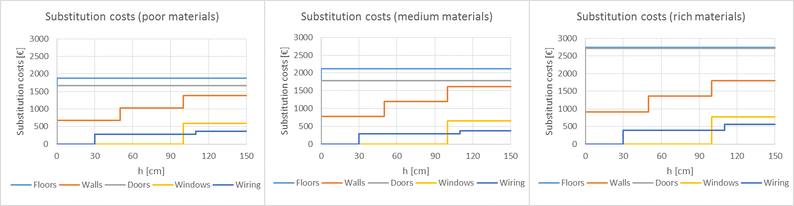
Development of master curricula for natural disasters risk management in Western Balkan countries
An integrated exposure-vulnerability approach for flood risk analysis in urban environments
Materials class | Water depth (cm) | Floors | Walls | Doors | Windows | Wiring | Gas system | Plumbing
Poor | 50 | 0.34 | 0.12 | 0.27 | 0.00 | 0.07 | 0.1 | 0.1
 | 100 | 0.32 | 0.17 | 0.24 | 0.00 | 0.07 | 0.1 | 0.1
 | 150 | 0.26 | 0.19 | 0.20 | 0.07 | 0.08 | 0.1 | 0.1
Intermediate | 50 | 0.34 | 0.12 | 0.29 | 0.00 | 0.05 | 0.1 | 0.1
 | 100 | 0.32 | 0.18 | 0.27 | 0.00 | 0.04 | 0.1 | 0.1
 | 150 | 0.26 | 0.20 | 0.22 | 0.08 | 0.04 | 0.1 | 0.1
Rich | 50 | 0.32 | 0.11 | 0.32 | 0.00 | 0.05 | 0.1 | 0.1
 | 100 | 0.31 | 0.15 | 0.30 | 0.00 | 0.04 | 0.1 | 0.1
 | 150 | 0.26 | 0.17 | 0.25 | 0.07 | 0.05 | 0.1 | 0.1
Notes:
Here a detail of the substitution costs of building elements for the different classes of finitures and the weight of their own curves in respect to the total vulnerability one.

Slide 25
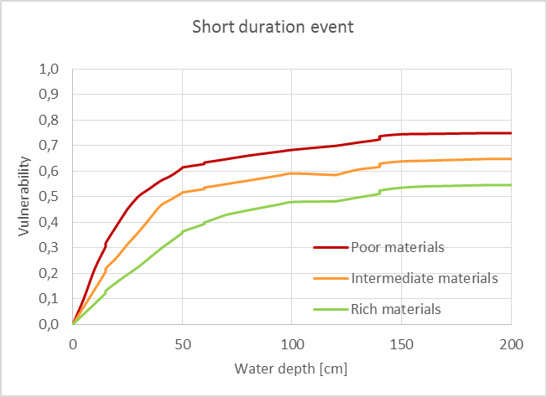
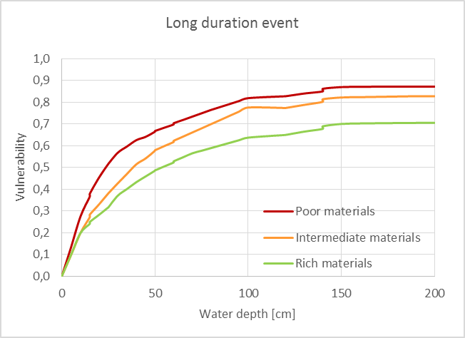
Development of master curricula for natural disasters risk management in Western Balkan countries
An integrated exposure-vulnerability approach for flood risk analysis in urban environments
Notes:
The highest value of the total vulnerability, as can be seen in the figure, was almost equal to 0.7. It was due to derived curves associated to each single element. As a synthesis of the questionnaire answers, none of them reached the vulnerability value of 1 (none of the experts experienced an inundation depth which caused the necessity of completely substitution of an element). This can be due to the fact that we asked to ignore structural damages: it is easy to imagine that a flood destroys its structural elements before causing so huge damages to all non-structural elements.
A double confront can be done about the curves based on their dependence on event duration, their variation with materials’ improvement and how this influence also the passage between short and long duration. Figures 6 and 7 show the curves for three classes of materials’ quality, grouped for short and for long duration event. The passage from poor to rich materials, as expected, corresponds to a decrease in relative damage, as better material suffer less flood damage in respect to poor ones.
This reduction is higher in short duration events, because poor materials suffer huge damages yet for short duration of water contacts, while good materials often need a simple clean-up intervention in these cases. It is instead lower for long duration events, because over a certain threshold poor materials reach a maximum damage (for us, it corresponds to the necessity of substitute the corresponding element), while rich ones go on suffering the consequences of water contact.

Slide 26
Development of master curricula for natural disasters risk management in Western Balkan countries
An integrated exposure-vulnerability approach for flood risk analysis in urban environments
Contents vulnerability curves
Commercial activities are mostly located in structures with the same materials and building characteristics of those used for residential activities, but the stock contents have higher weights in the damage estimation. To include this contribution, the curves from the MCM relative to the movable equipment of different commercial activities were converted according to the ratio of the GDP pro capita of England and Italy, and the currency rate.
The total vulnerability curve for each commercial building class was derived by summing the materials and the contents contributions.
Notes:
While the materials of commercial buildings shares mostly the same characteristics to the residential ones, the stock contents have higher weights in the damage estimation in the former such that the vulnerability curves should include the contribution of movable equipment. To include this contribution, the curves from the MCM relative to the movable equipment of different commercial activities were converted by considering the different GDP pro capita of England and Italy, and the currency rate.
The total vulnerability curve for each commercial building class was derived by summing the materials and the contents contributions and the resulting curves were then expressed as relative damage (vulnerability) curves.
Figures 10 and 11 show the absolute damage per m2 and the relative damage (vulnerability) curves for restaurants with intermediate materials. The maximum content damage £157/m2, derived from the MCM, was associated to restaurant, which counted 60% of the total damage in the vulnerability curve. When summing up the materials and the contents absolute curves, the total damage for restaurants increases in respect to the only materials contribution. Vice versa, when reporting the curves to their relative damage value, the total curve decreases because of the lower percentage of damage associated to contents in respect to the one associated to materials.

Slide 27
Development of master curricula for natural disasters risk management in Western Balkan countries
An integrated exposure-vulnerability approach for flood risk analysis in urban environments
Notes:
The proposed methodology was applied for the qualitative assessment of flood consequences in Barcellona Pozzo di Gotto (Italy), a small town hit by an inundation event on 22th November 2011. The town is crossed by the Longano river, which has a main slope of 0.18 and flows inside levees. The river is crossed by three small bridges and two coverages limiting its section.
On 22 November 2011 a severe thunderstorm caused the inundation of the area: the water came out at first from small levee opening but, during the peak discharge, the majority of inundation volumes was due to the overtopping in correspondence to a bridge. Almost 800 buildings were reached from the water, one hundred of which hold (lodge?) commercial activities.

Slide 28
Development of master curricula for natural disasters risk management in Western Balkan countries
An integrated exposure-vulnerability approach for flood risk analysis in urban environments
Contents damage curve from MCM | Commercial activities
High Street shop | Clothing and shoe stores, jewelleries, perfumeries, furniture shops, newsstands, curio shops, photo shops, book shops, toy stores, pet shops
Bank | Banks
Hotel | Hotels
Sport, Leisure centre | Sport and leisure centres
School, University, College | Nurseries
Surgery | Surgeries, dental practices, orthopedists, drugstores
Car Showroom | Car showrooms, car parks
High Tech Office | Post offices, copy shops, typographies, phone shops, appliance stores
Office non specific | Freelancer offices, estate agencies, travel agencies, driving schools
Bingo | Betting centres, slot machines, billiards
Restaurant | Restaurants, pizzerias
Cafe, Fast food | Cafes, confectioneries, ice-cream shops, candy shops, bakeries, rotisseries
Super, Hyperstore | Fish markets, butcher's shops, delicatessens, greengroceries
Electrical warehouse | Boilers shop
Retail warehouse | Ironmongeries, poundlands, electronics stores, hydraulic supplies shops, retailers of articles for hairdressers
Laboratory | Laundries
Hair Saloon | Hair Saloons
Garden centre | Flower shops
Garage, vehicle repair | Garages, vehicle repairs, retailers of spare parts for cars and motorcycles
Notes:
The contents vulnerability contribution was derived by converting the corresponding curves from MCM. The different commercial activities were grouped according to the classes considered in MCM manual, as listed in Table 3. Figure 9 shows the map of the commercial activities in the study area.

Slide 29
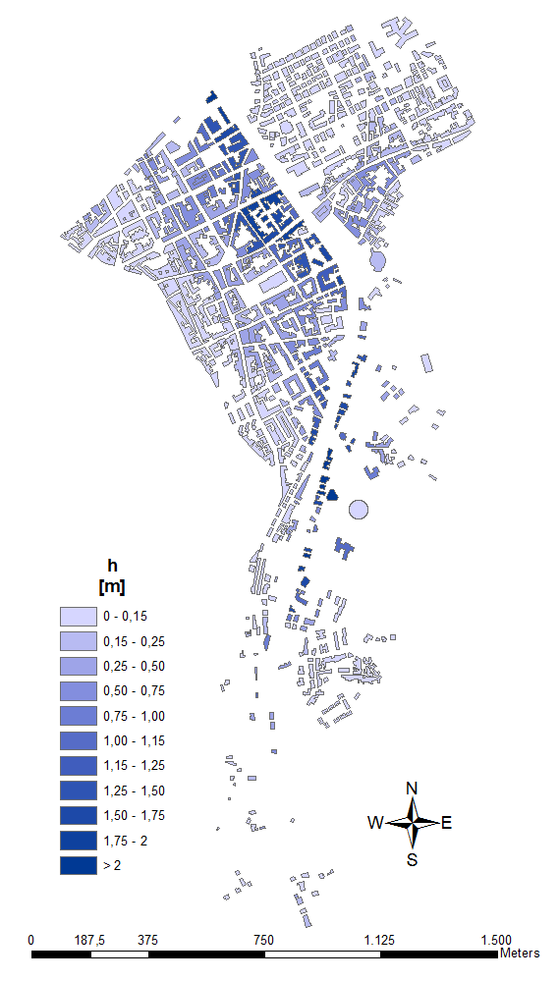
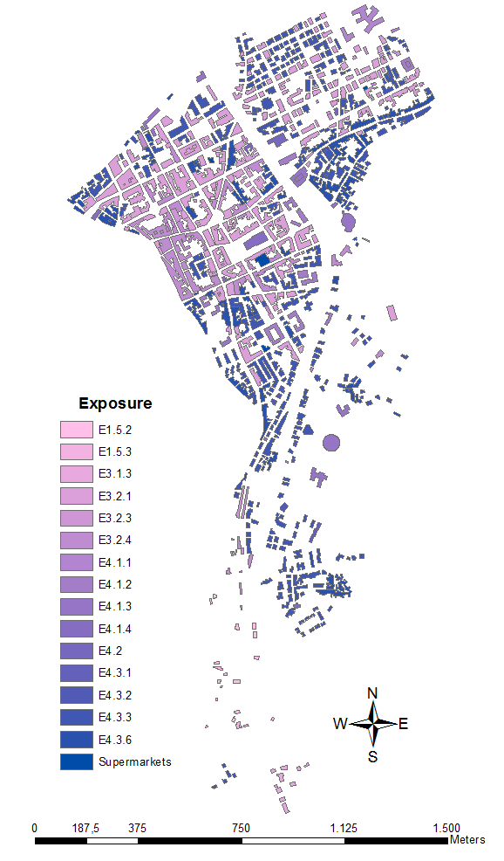
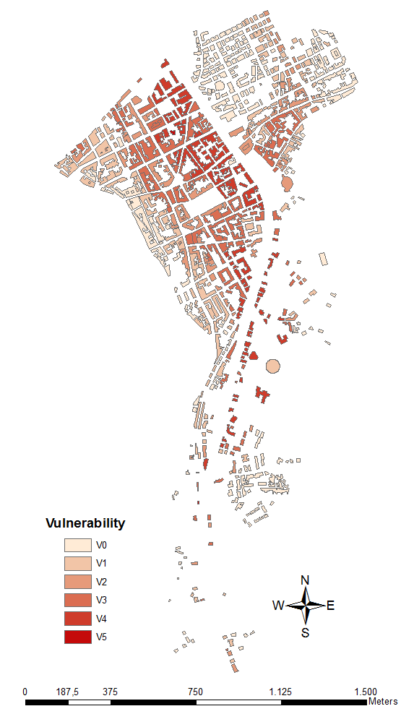
Development of master curricula for natural disasters risk management in Western Balkan countries
An integrated exposure-vulnerability approach for flood risk analysis in urban environments
Notes:
Exposure classification provides strategically indications about flood consequences, but it does not allow for their quantitative estimation. The comparison of exposure and vulnerability maps, instead, can identify immediately the buildings or sensitive areas that are associating with high vulnerability or vice versa, thus completing each other the information on flood consequences. Moreover, as same vulnerability curves are associated to same featured buildings, the only way to know if they cover different roles is consulting their exposure class.
The results of vulnerability analysis have been reported both in maps and in an Exposure-Vulnerability matrix (Table 4), which summarises the overall situation of a catchment that can be compared between different scenarios.

Slide 30
Development of master curricula for natural disasters risk management in Western Balkan countries
An integrated exposure-vulnerability approach for flood risk analysis in urban environments
 | E-V | V1 | V2 | V3 | V4 | V5
Sparse houses | Single houses | 0.09% | 0.09% | - | 0.09% | -
 | Flats | 0.26% | 0.09% | 0.26% | 0.09% | -
Industrial and craft settlements | Farmhouses | 0.26% | 0.34% | 0.09% | - | -
 | Single houses | 2.33% | 1.03% | 1.90% | 1.21% | 0.34%
 | Sheds | 1.12% | 0.09% | 0.43% | 0.09% | -
 | Box/Garage | 11.72% | 10.78% | 10.09% | 7.33% | 0.34%
Supermarkets |  | 0.09% | 0.09% | 0.09% | - | 0.09%
Residential buildings | Single houses | 1.38% | 0.52% | 1.12% | 1.03% | 0.26%
 | Flats | 7.07% | 3.53% | 3.19% | 2.50% | 1.90%
 | Detached houses | - | - | - | - | -
 | Villas | 0.17% | 0.09% | 0.17% | 0.26% | -
Civil Protection Areas and Police offices |  | 0.26% | - | - | 0.09% | -
Important public buildings | Town hall and municipal offices | 0.17% | 0.09% | 0.34% | 0.43% | 0.09%
 | Schools | 0.17% | 0.17% | 0.09% | 0.17% | 0.34%
The idea of bypassing the assets’ economical value and using exposure classes may allow to reduce uncertainties.
The construction of a E-V matrix allow both to understand the actual situation of a catchment (and the possible consequences of a flood event) and to study the effectiveness of non-structural measures for a site, just studying how their implementation modifies the distribution of elements at risk inside it.
Notes:
In each cell of the matrix, it can be seen which percentage of the total number of buildings (1160) is associated to each vulnerability class, distinguished for the different exposure classes. The coloured bands, to be distinguished from the vulnerability ones, help in identifying areas that are more sensitive. They change from green to dark red, as the E-V classification worsen: this happens either for “low” exposure/high vulnerability classes, or for “high” exposure/low or high vulnerability ones.
The Exposure-Vulnerability matrices allow the decision makers to overview the actual state of a territory including the possible consequences of a flood event, and to compare it with the eventual conditions of the same territory subjected to the same event but differently protected, thus evaluate the effectiveness of non-structural measures for impact reduction via quantified indicators. The matrix summarizes the impact of different building types (sectors) such that the flood risk managers can prioritize their tasks to allocate resource to maximize the benefits of flood mitigation measures.

Slide 31
Development of master curricula for natural disasters risk management in Western Balkan countries
Synthesis
Urban areas can be flooded by rivers, coastal floods, pluvial and ground water floods, and artificial system failures.
Flood risk management plans “shall address all aspects of flood risk management focusing on prevention, protection, preparedness, including flood forecasts and early warning systems”
Studies addressed to the evaluation of flood vulnerability are few and at the mercy of so many elements of uncertainty difficult to quantify.
The lack of high-quality basis data is mentioned as one of the main obstacle to flood vulnerability assessment.

Slide 32
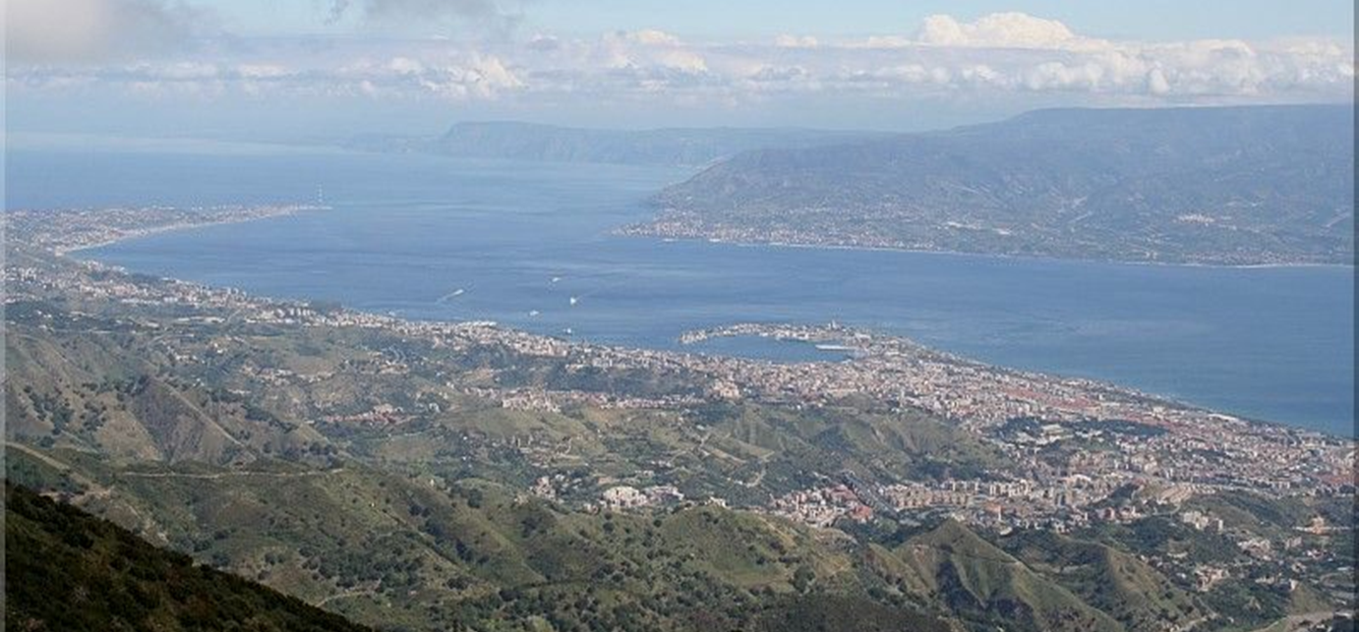
Thank you for your attention
Development of master curricula for natural disasters risk management in Western Balkan countries

